Slide 1
C++ Basics II

Slide 2
Homework review

Slide 3
SCOpe

Slide 4
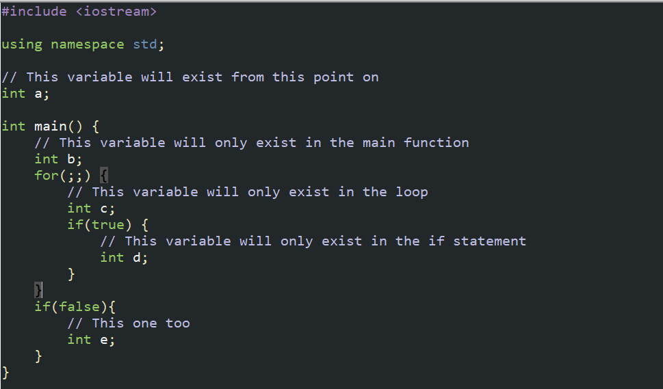
What is scope?
Scope is the domain in which a variable can exist.

Slide 5
Type casting

Slide 6
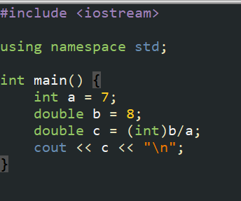

What is typecasting?
Type casting is converting one data type to another compatible data type.
For example, we can make an integer a double, or vice versa.
This code will output: While this will output:
1 1.14286

Slide 7
What can you type cast?
You can type cast any primitive data type to any other primitive data type, however we usually deal with integers the most.
int <-> bool
int <-> char
int <-> double/float
*You cannot type cast strings*

Slide 8
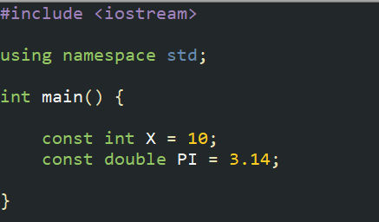
Constant variables
Constant variables are variables that cannot be modified or assigned a value other than initialization.

Slide 9
Arrays

Slide 10
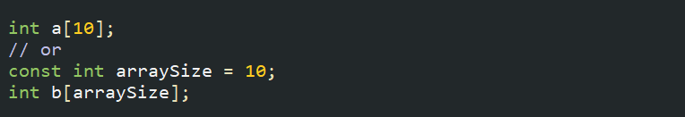
What are arrays?
Arrays are one of the most useful things we have in programming. They can contain multiple instances of a data type.
If a variable is a book, then an array is a bookshelf.
We declare arrays in c++ like so (10 is the size of the array):
In c++, we have to use a constant integer to declare array sizes.

Slide 11
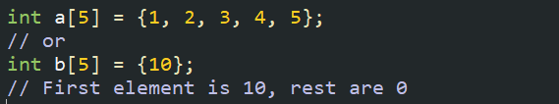
Array declaration
You can also declare arrays like this:
When you declare an array of primitive data types, the values will be set to default values of 0.

Slide 12
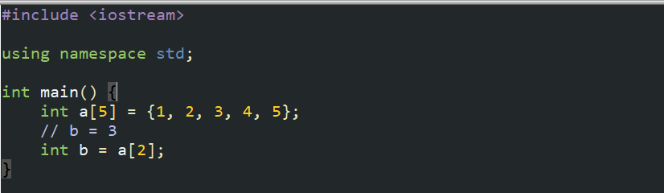

Array access
Arrays are 0-indexed and you can retrieve a value like so:
You can also assign values to specific indexes:

Slide 13
exercise 1
Create an array with numbers from 1-100 and print them in this order:
1 100 2 99 3 98…

Slide 14
exercise 2
Strings are considered an array of characters! Take in a string (input) and check if it’s a palindrome or not.

Slide 15
homework 1
Imagine you have 10000 closed lockers. Do the following:
Starting from locker 1, open every single locker.
Then go back to locker 2, and close every other open locker
Go back to locker 3, and every third locker, close it if it is open, and open it if it is closed.
Print out every locker number that is closed at the end.

